Slide 1
Integration between pax and e-commerce
2021/2/22 version

Slide 2
Model parameter estimation
Use 2019 NYC Citywide Mobility Survey
“No. of grocery deliveries” and “shopping trips” in a day
Estimate binary logit mixture models (the coefficient of the logarithm of no. of grocery deliveries and its SD (normal distribution))
Day pattern travel (1 if travel; 0 otherwise)
Day pattern tours (1 if pattern include shopping; 0 otherwise)
Day pattern stops (1 if pattern include shopping; 0 otherwise)
Parameters for “no. of tours (shopping)” can not be estimated as 98.6% of samples do only single shopping tour.
Regression controlling socio-economic characteristics indicate 1 increase in grocery delivery (order) leads to 0.15 decrease in shopping trips

Slide 3
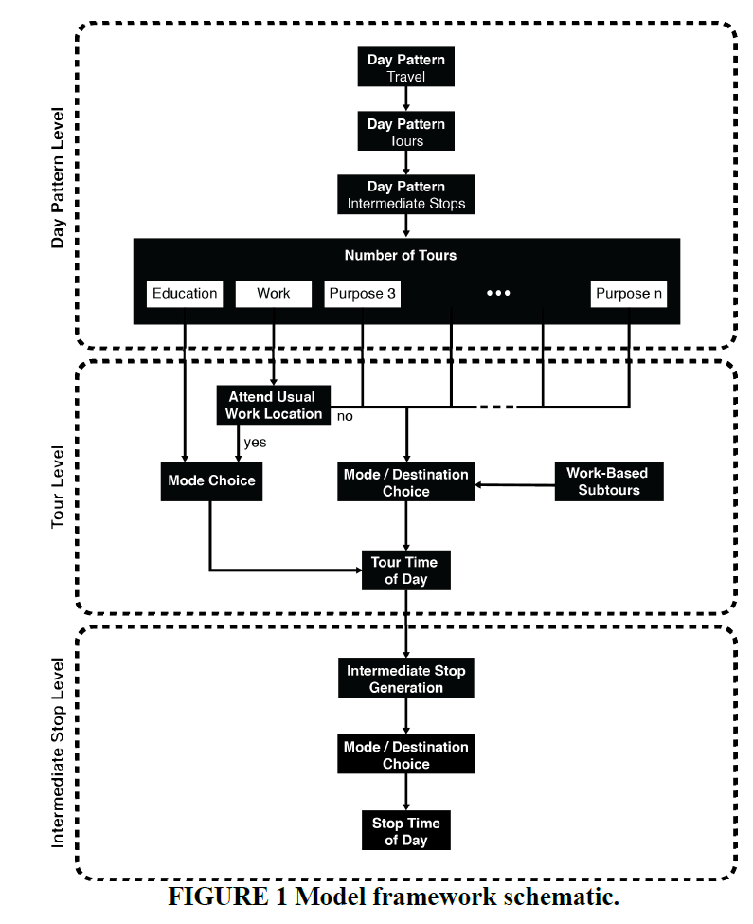
Day pattern travel
(1 if travel; 0 otherwise)
Day pattern tours (1 if pattern include shopping; 0 otherwise)
Day pattern stops (1 if pattern include shopping; 0 otherwise)
 | Coefficient | S.E.
intercept | 1.47 | 0.02
log(grocery delivery +1) | -0.05 | 3.10
sd.log(grocery delivery +1) | 0.60 | 13.06
 | Coefficient | S.E.
constant | -0.89 | 0.02
log(grocery delivery +1) | -0.61 | 92.47
sd.log(grocery delivery +1) | 3.43 | 253.12
 | Coefficient | S.E.
constant | -1.00 | 0.02
log(grocery delivery +1) | -0.46 | 1.18
sd.log(grocery delivery +1) | 0.28 | 10.37

Slide 4
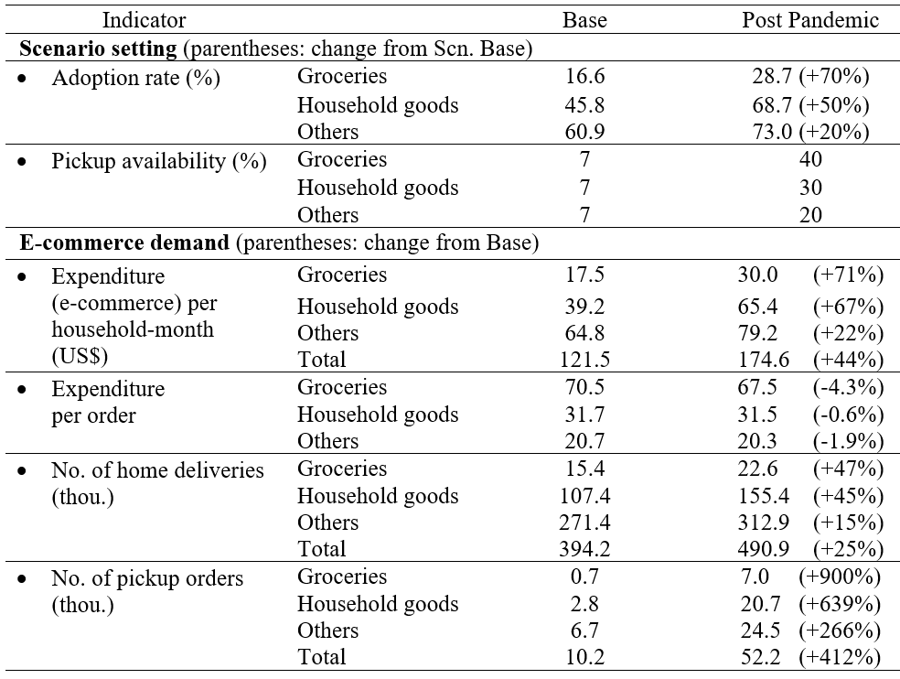
Preliminary sensitivity test
Use the e-commerce demand on the right table (for AI)
Assume the base logit value based on a previous preday run (the same value for all individuals)
(= the utility is same for all individuals except the term with the e-commerce demand)
Assume the coefficients of non grocery demand is 1/3 of grocery demand
To redo after C++ implementation

Slide 5
Result
 |  | Base | PP | ratio (PP/Base) | Change in shopping stop counts (per day)¹⁾
Ave. Pr (%) of travel = 1 | a. all | 86.0 | 86.0 | 1.000
 | b. Those using e-commerce for grocery shopping (>= 1 per month) | 85.9 | 85.9 | 1.000
 | b/a | 0.999 | 0.999
Ave. Pr (%) of tour (shop) = 1 | a. all | 30.0 | 29.9 | 0.998 | - 9,010¹⁾
 | b. Those using e-commerce for grocery shopping (>= 1 per month) | 29.5 | 29.5 | 1.000
 | b/a | 0.983 | 0.985
Ave. Pr (%) of intermediate stop (shop) = 1 | a. all | 6.6 | 6.6 | 0.996 | - 14,442²⁾
 | b. Those using e-commerce for grocery shopping (>= 1 per month) | 6.4 | 6.4 | 0.996
 | b/a | 0.970 | 0.970
1) Assume a decrease of the choice [primary tour pattern includes shipping] leads to a decrease in shopping stop by 1.
2) Assume a decrease of the choice [intermediate stop pattern includes shipping] leads to a decrease in shopping stop by 1.
Change in shopping stop per day (excluding pickup) | -23,452
Change in home delivery per day | 96,700
Change in pickup orders per day | 42,000

Slide 6
END

Slide 8
Two mechanisms
EC order freq. influences shopping activity.
Changes will be made on Day Pattern Level
Pax Preday – Day Pattern
EC order freq. per month (both delivery and pickup)
Travel Binary
EC model
Tours
(Util. fn. of patterns including shopping)
Intermediate stops
(Util. fn. of patterns including shopping)
logsum of the shopping mode-destination choice models
No. of tours
(Util. fn. of shopping)
2. EC “pickup” generate pickup tours and/or trips
EC model predicts a pickup incident, and this will be added to a DAS as a home-based tour OR an intermediate stop in an existing tour

Slide 9
Integration between pax and e-commerce
2021/2/1 version

Slide 10
Progress
Specified implementation document
Make “no. of E-commerce order month” available in lua files
Add pickup (shopping) trips
Estimate of substation effect between e-commerce and shopping trip
Substitution effect cannot be estimated so far although various methods were tested (following slides).

Slide 11
Attempted methods
Objective:
Estimate the level of substitution between E-commerce orders and shopping trips.
Use detailed categories
Control by the combination of the following variables
Occupation, Education attainment, Part-time/Full-time, Student status, Age, Household composition(with child, only workers), Vehicle ownership
(-> positive coefficients)
Use pooled data (with the category & year controlled)
(-> positive coefficients)
Use matching method (difference-in-difference model with the category controlled)
Perfect match based on the above variables plus:
Gender, Time to work, Use of car to work, HH income, Population density of HH location, Census division – MSA – presence of a subway – population, State
(-> positive coefficients)

Slide 12
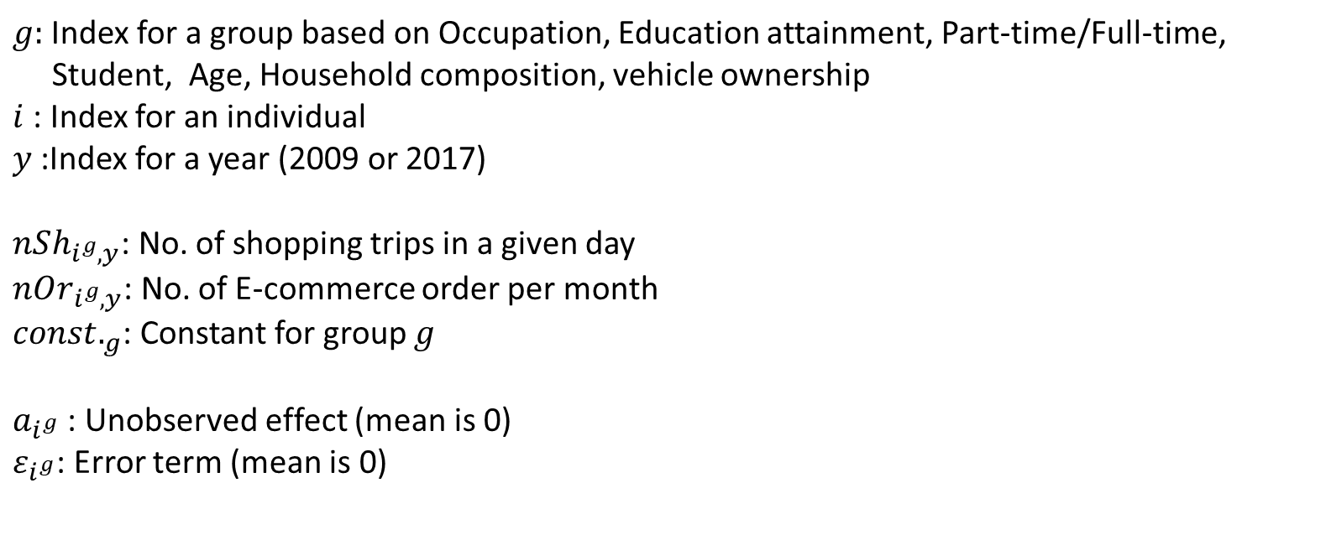
Potential Problem
Individuals in group (=category) $g$ have the same observable characteristics.
$$nSh_{i^{g},y}=α_{g}∙nOr_{i^{g},y}+const._{g,y}+a_{i^{g},y}+ε_{i^{g},y}$$
+
+
$g:$ Index for a group based on Occupation, Education attainment, Part-time/Full-time, Student, Age, Household composition, vehicle ownership
$i$: Index for an individual
$y$:Index for a year (2009 or 2017)
$nSh_{i^{g},y}$: No. of shopping trips in a given day
$nOr_{i^{g},y}$: No. of E-commerce order per month
$const._{g}$: Constant for group $g$
$a_{i^{g}}$ : Unobserved effect (mean is 0)
$ε_{i^{g}}$: Error term (mean is 0)

Slide 13
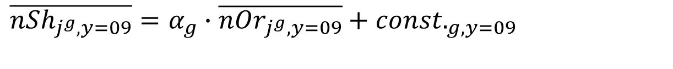
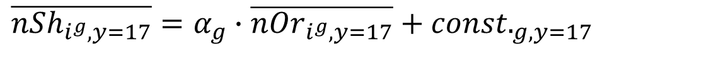
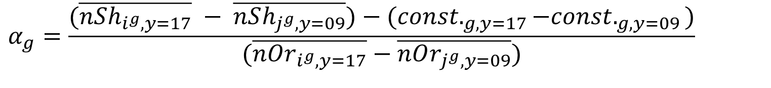
Use of an aggregate approach with two cross-sectional data (2009 samples are those matched with 2017 samples)
$$\overline{nSh_{i^{g},y=17}}=α_{g}∙\overline{nOr_{i^{g},y=17}}+const._{g,y=17}$$
$$\overline{nSh_{j^{g},y=09}}=α_{g}∙\overline{nOr_{j^{g},y=09}}+const._{g,y=09}$$
$$α_{g}=\frac{(\overline{nSh_{i^{g},y=17}} − \overline{nSh_{j^{g},y=09}})−(const._{g,y=17}−const._{g,y=09})}{(\overline{nOr_{i^{g},y=17}}−\overline{nOr_{j^{g},y=09}})}$$
$$const._{g,y=17}−const._{g,y=09}≅\overline{nSh_{i^{g}∈I_{nOr=0},y=17}} −\overline{nSh_{i^{g}∈I_{nOr=0},y=09}}$$
is used.

Slide 14
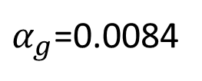


Still, positive coefficients: Example
Fulltime worker, age35-50,without child, adults are all workers, 1 car, job: professional/managerial/technical, edu.: college/university degree (n=260)
$α_{g}$=0.0084
$$−0.04$$
$$−0.07$$
Note: also tried with a more detailed group with same income, state, urban/rural, mins. to work, use of car for work, sex…

Slide 15
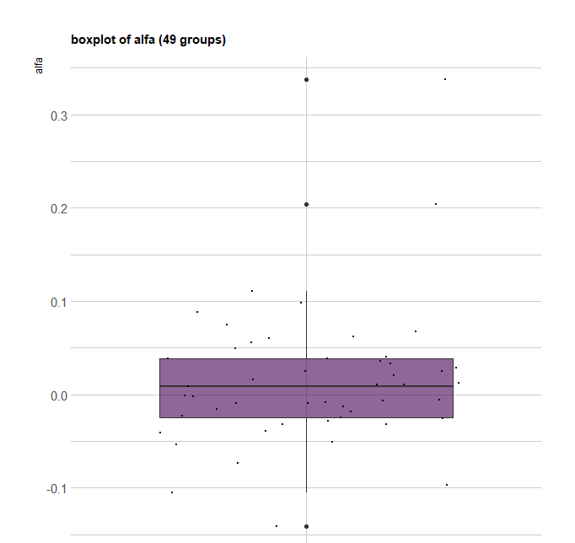

$α_{g}$ of 49 groups
48 groups and others (small groups were merged)

Slide 16
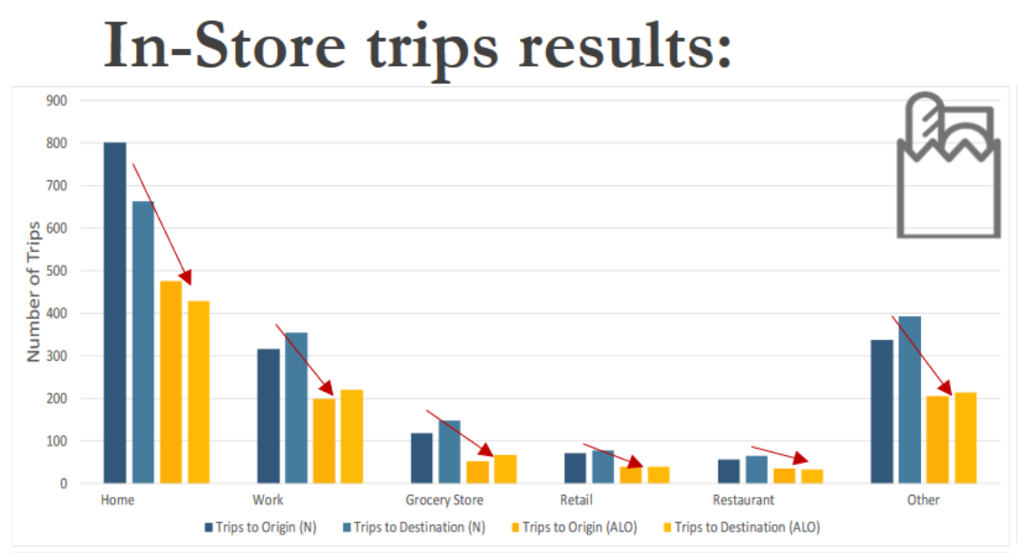
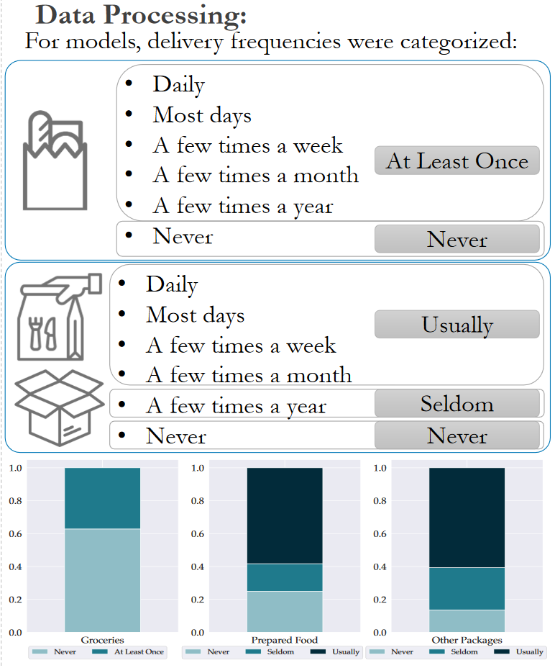
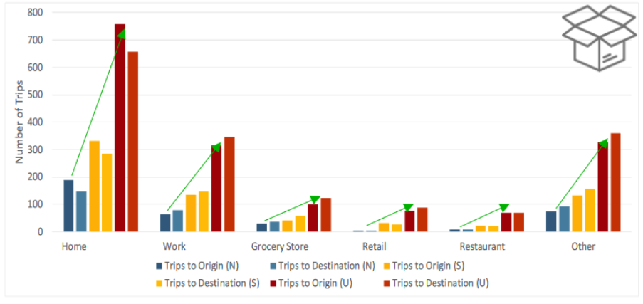
The Impact of Online Ordering Frequency in New York City's Planning. Delivery Plans for the City or the Neighborhood?
Tejada & Conway (TRB 2021)
With the NY data, substitution is observed for groceries.

Slide 17
To Do
The similar analysis using 2019 NYC Citywide Mobility Survey
Publically available
Sample size: 3346; 186 households do grocery shopping online.

Slide 18
END

Slide 19
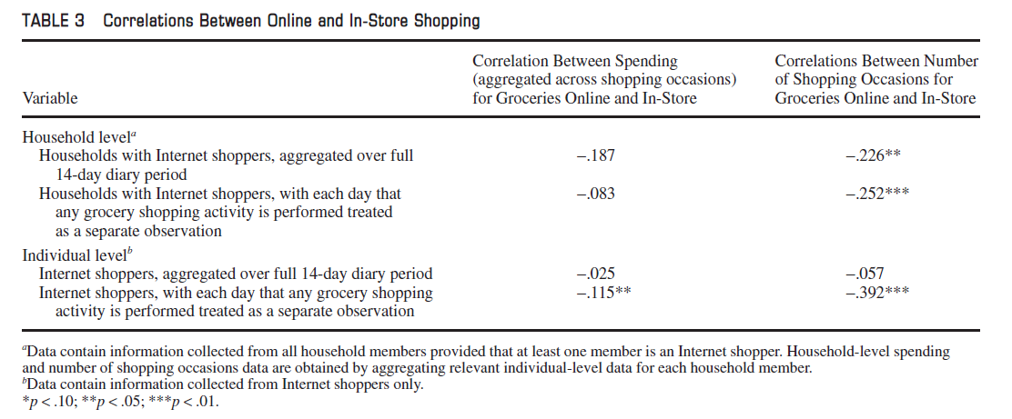

Slide 20
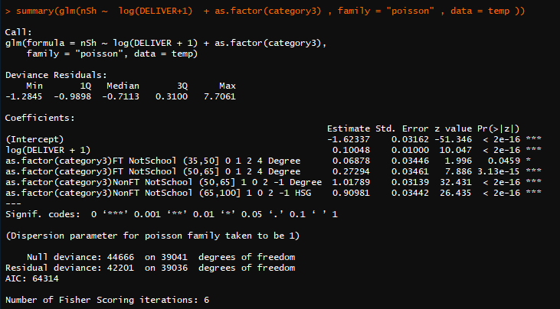
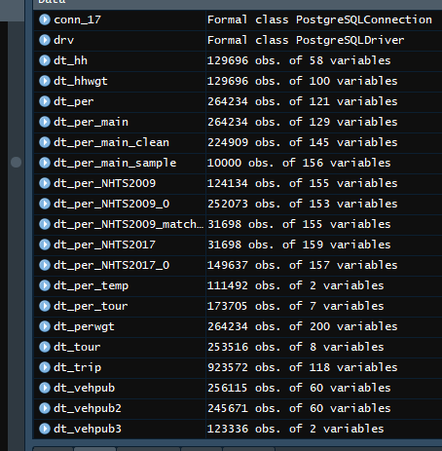
For record: Poisson reg.:five large groups

Slide 21
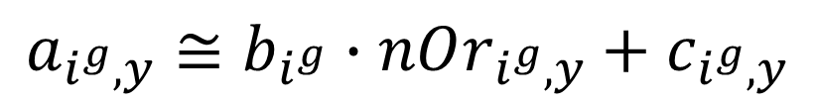
$$nSh_{i^{g},y}=(α_{g}+b_{i^{g}})∙nOr_{i^{g},y}+const._{g,y}+c_{i^{g},y=1}+ε_{i^{g}}$$
$$nSh_{i^{g},y}=(α_{g}+b_{i^{g}})∙nOr_{i^{g},y}+const._{g,y}+c_{i^{g},y=0}+ε_{i^{g}}$$

Slide 22
Integration between pax and e-commerce
2021/1/14 version

Slide 23
Two mechanisms
EC order freq. influences shopping activity.
Changes will be made on Day Pattern Level
Pax Preday – Day Pattern
EC order freq. per month (both delivery and pickup)
Travel Binary
EC model
Tours
(Util. fn. of patterns including shopping)
Intermediate stops
(Util. fn. of patterns including shopping)
logsum of the shopping mode-destination choice models
No. of tours
(Util. fn. of shopping)
2. EC “pickup” generate pickup tours and/or trips
EC model predicts a pickup incident, and this will be added to a DAS as a home-based tour OR an intermediate stop in an existing tour

Slide 24

Use of NHTS – Summary
Analyze the effect of EC Order (“Count of Times Purchased Online for Delivery in Last 30 Days”) on travel pattern
EC Order data is available both for 2017 NHTS and 2009 NHTS
If a single year data is used for a regression:
No. of shopping trips and EC order are positively correlated when individual and HH characteristics (employment status, student status, age, HH income, HH size, vehicle ownership) are controlled
Problem of Endogeneity
Using 2017 NHTS (sample size: 100k)
$$\log\left(No. Shopping Trip_{n}+1\right)=0.031\log\left(No. EC prder_{n}+1\right)+\sum_{i}{β_{i}∙Control_{i}}$$
(S.E.: 0.0025)
$n:$ Index for person-day
$Control_{i}$: Binary variable for category i (1 if category i; 0 otherwise)
Use 2009 and 2017 data

Slide 25
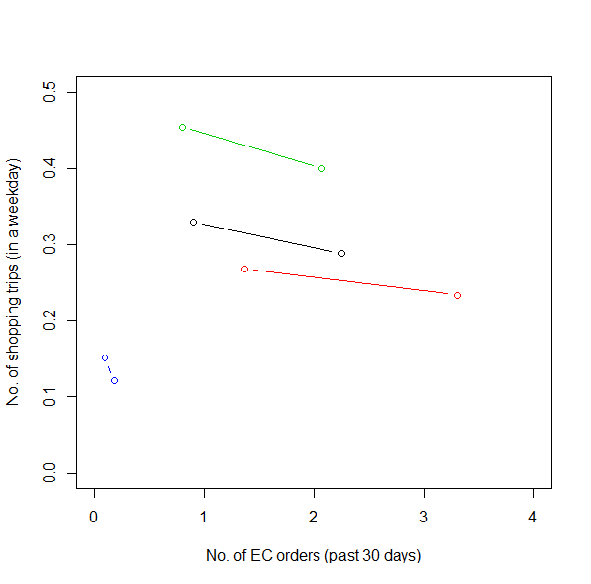
Use of 2009 & 2017 data
Weights for 2009 data was re-adjusted based on employment status, student status, age, HH income, HH size, vehicle ownership to make it comparable with 2017 data.
Compare the average no. of shopping trips and no. of EC orders.
2009
2017
2009
2017
2017
2009
2009
Slop for “all”: -0.031
Black: All
Red: Full time worker
Blue: Student non-worker
Green: Others
1.00 increase in EC order per day leads to 0.93 decrease in Shopping trip per day
2017

Slide 26
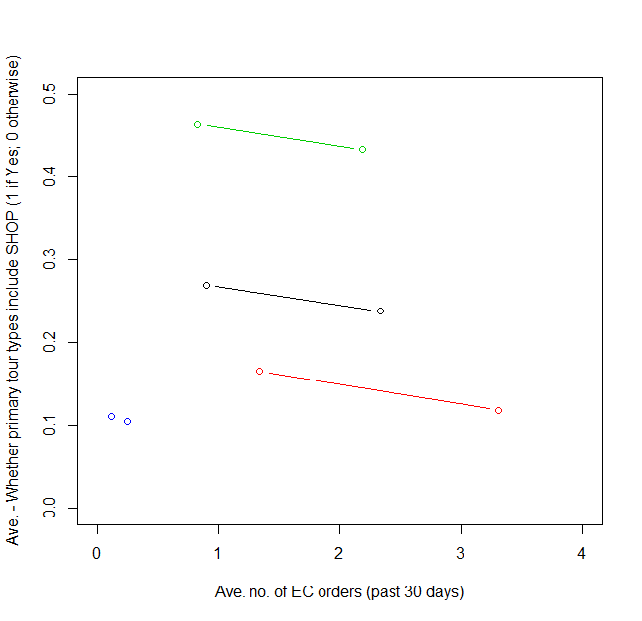
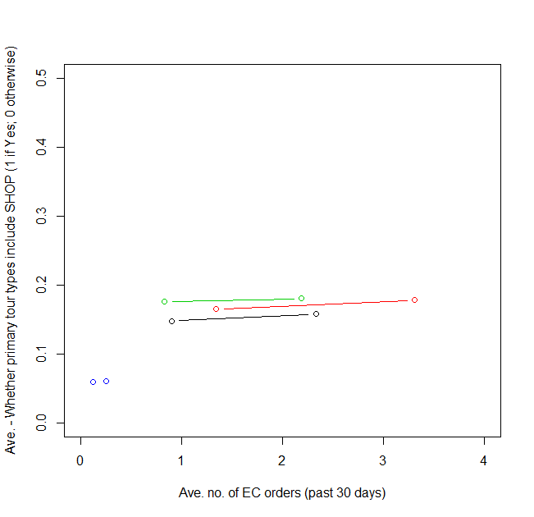
Samples: Person-days who travel in a survey date
Whether primary tour types include SHOP (1 if Yes; 0 otherwise)
Whether intermediate stops include SHOP (1 if Yes; 0 otherwise)
2009
Black: All
Red: Full time worker
Blue: Student non-worker
Green: Others
2017
Black: All
Red: Full time worker
Blue: Student non-worker
Green: Others
2009
2017
2009
2009
2009
2017
2017
2009
2017
2017
2017
2009
2017
2009

Slide 27
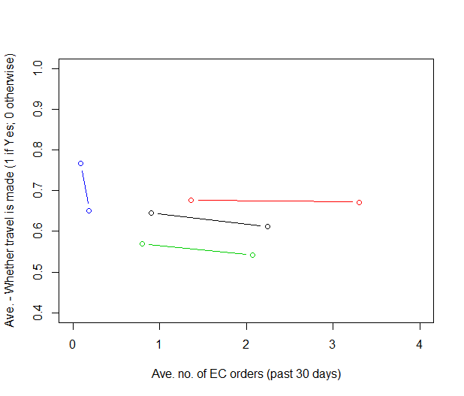
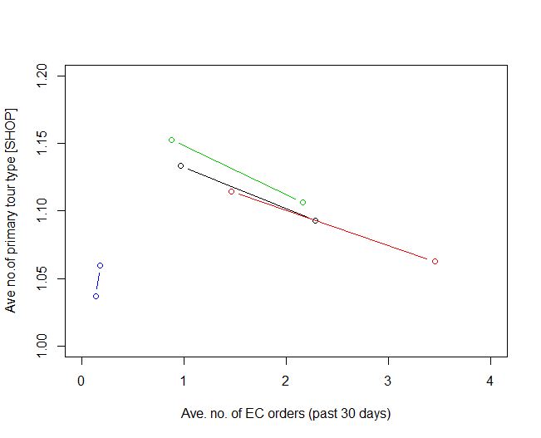
Samples: All person-days
Samples: Person-days whose primary tour types include SHOP
Whether travel is made (1 if Yes; 0 otherwise)
No. of primary tour type [SHOP]
Black: All
Red: Full time worker
Blue: Student non-worker
Green: Others
2009
2009
2009
2017
2009
2017
2009
2017
2009
2017
2017
2017
2017
2009
2017
2009

Slide 28
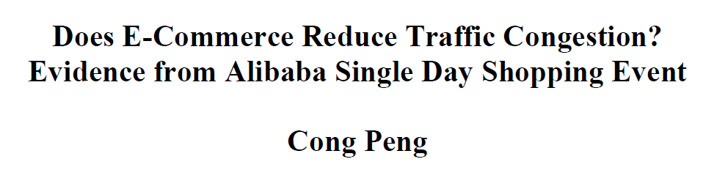
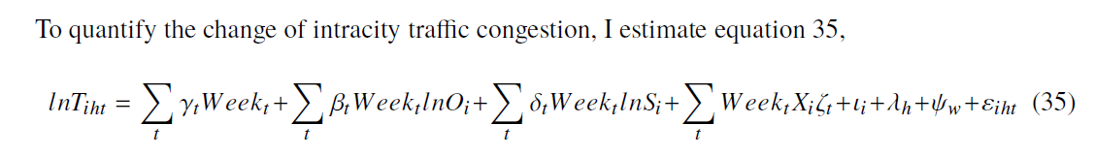
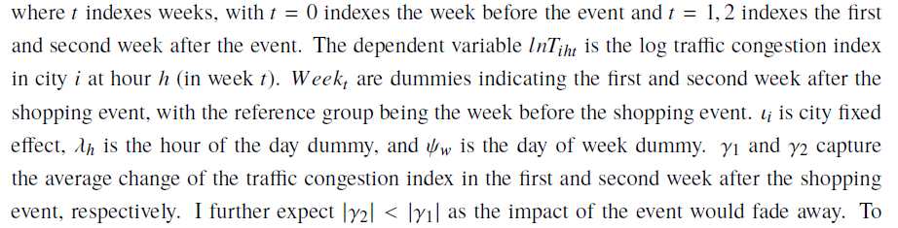
10% increase in online shopping causing a 1.4% reduction in traffic congestion
Use online shopping index & traffic congestion index

Slide 29
Appendix
Pls ignore the following slides

Slide 31
Use of 2017 NHTS
Impact of EC Order (“Count of Times Purchased Online for Delivery in Last 30 Days”) on travel pattern
Original sample size
264k person-day
Binary logit for:
Day Pattern – Tour Type (primary)
Whether primary tour types include SHOP
Day Pattern – Intermediate Stops
Whether intermediate stops include SHOP
100k were re-sampled considering weights
EC Order has positive effect on Day Pattern – Binary: likely omitted variable bias

Slide 32
Analysis
The interaction with following individual/household level characteristics are considered:
Full-time worker/Part-time worker/Student non-worker/Others
Age
Gender
Car ownership
Income level

Slide 33
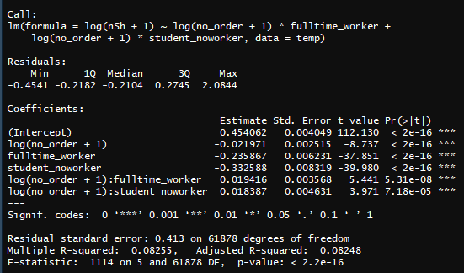
Preliminary analysis
Estimate a regression model (DV: log(no. of shopping trips))
Three categories are considered:
Full-time worker
Student non-worker
Others (base)
Almost no effect for full-time worker and student non-worker

Slide 34

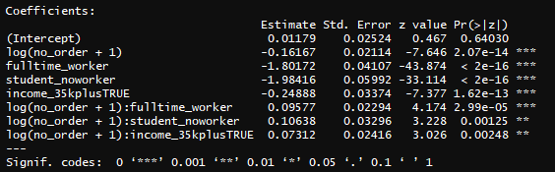
Results - Day Pattern – Tour Type (primary)
EC order elasticity of Odds (Day Pattern with Primary Tour Type “SHOP”)
 | HH income (US$)
 | Less than 35k | 35 or more
Full-time worker | -0.066 | 0.007
Student non-worker | -0.055 | 0.018
Others | -0.162 | -0.089
Some categories are positive

Slide 35



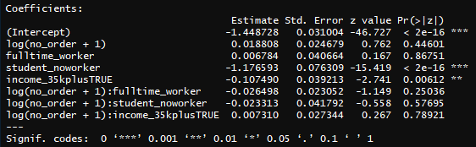
Results - Day Pattern – Intermediate Stops
No effect on inter-mediate stops (Whether intermediate stops include SHOP)
Of course… those impacted are “Others”, who do not have WORK and SCHOOL trips

Slide 36
Results - Day Pattern – Intermediate Stops

Slide 37
Those who do online shopping is more likely to do shopping activities (derived demand)

Slide 38

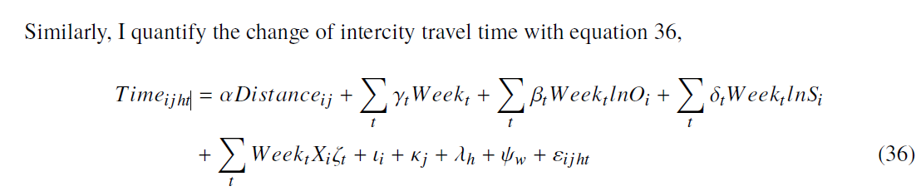
10% increase in online shopping causing a 1.4 reduction in traffic congestion
Online shopping index & traffic congestion index

Slide 39
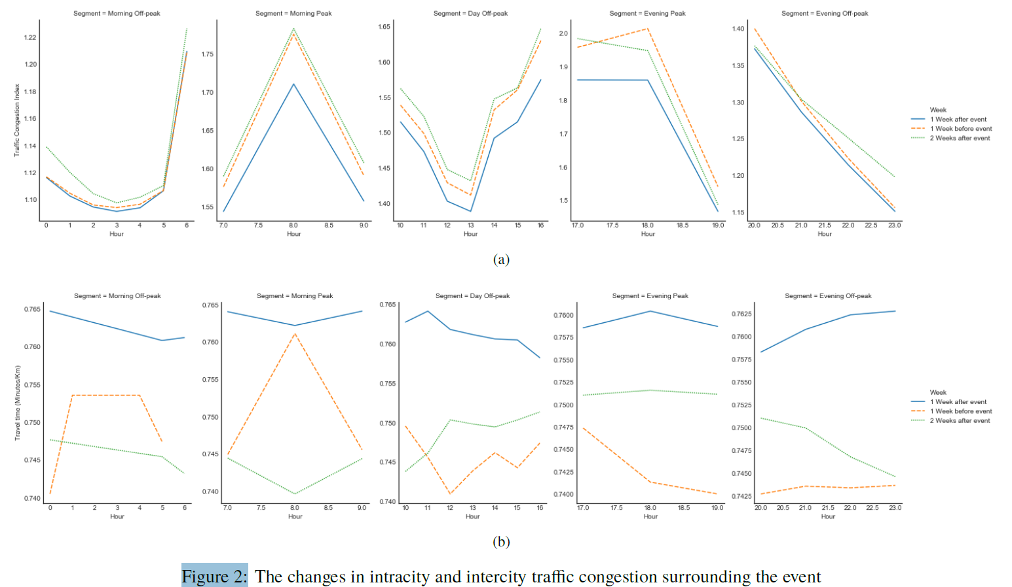

Slide 40
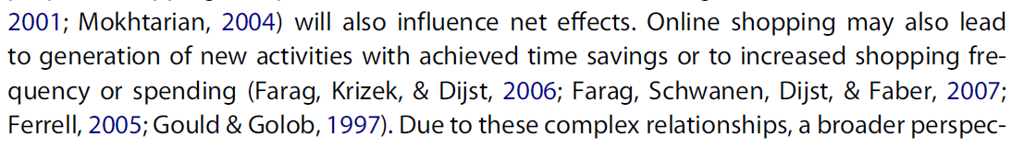
Complementarity effects / substitution effects
Item categories

Slide 41
Next stops
Analyze 2017 NHTS to identify the impacts of e-commerce on trips
Update Preday
Calibrate the model

Slide 42
Previous slides

Slide 43
Three potential approaches for pickup trips
Alt.1 Consider pickup trips as the same with shopping trips
Relatively easy
Pickup freq. is an input for Day Pattern & No. of Tours
Pickup accessibility cannot be differentiated with shopping accessibility
Alt.2 Consider new tour (?) and activity type: EC pickup
Relatively difficult
New day patterns with pickup need to be considered
Pickup accessibility (and locations) can be defined separately from in-store shopping
Alt.3 Develop a heuristics to insert pickup trips
Pickup location needs to be modeled
Heuristics will insert pickup trips into the activity schedules

Slide 44
Notes / Framework rationale
Order happening in a day != receiving or picking up on same day
We do not necessarily need to cut/add trips based on order occurrence
Instead, we could capture influence between orders and tours/trips, by changing their likelihood of occurrence
Moreover, full consistency doesn’t need to be achieved between orders and activities
E.g. “selecting” an individual to pickup a given order delivered to a shop
This would be a similar concept to not having vehicle ownership and mode choice consistency at household level

Slide 45
Consumer interaction with shopping
Delivery (B2C)
Home, Work, etc.
Pickup
Locker (not yet represented)
Shop (~B2B)
Typical
Alternative
How to choose those destinations without a proper representation of a pickup network?
Locations which might not overlap with Home, Work or Typical shopping locations.

